Slide 1
Software Testing
A (brief) introduction

Slide 2
THOU SHALT TEST

Slide 3
WHY?

Slide 4
Defective Software
We develop programs that contain defects
How many? What kind?
Hard to predict the future, however… it is highly likely, that the software we (including you!) will develop in the future will not be significantly better.

Slide 5
Defects cause failures
Communications: Loss or corruption of communication media, non delivery of data.
Space Applications: Lost lives, launch delays.
Defense and Warfare: Misidentification of friend or foe.

Slide 6
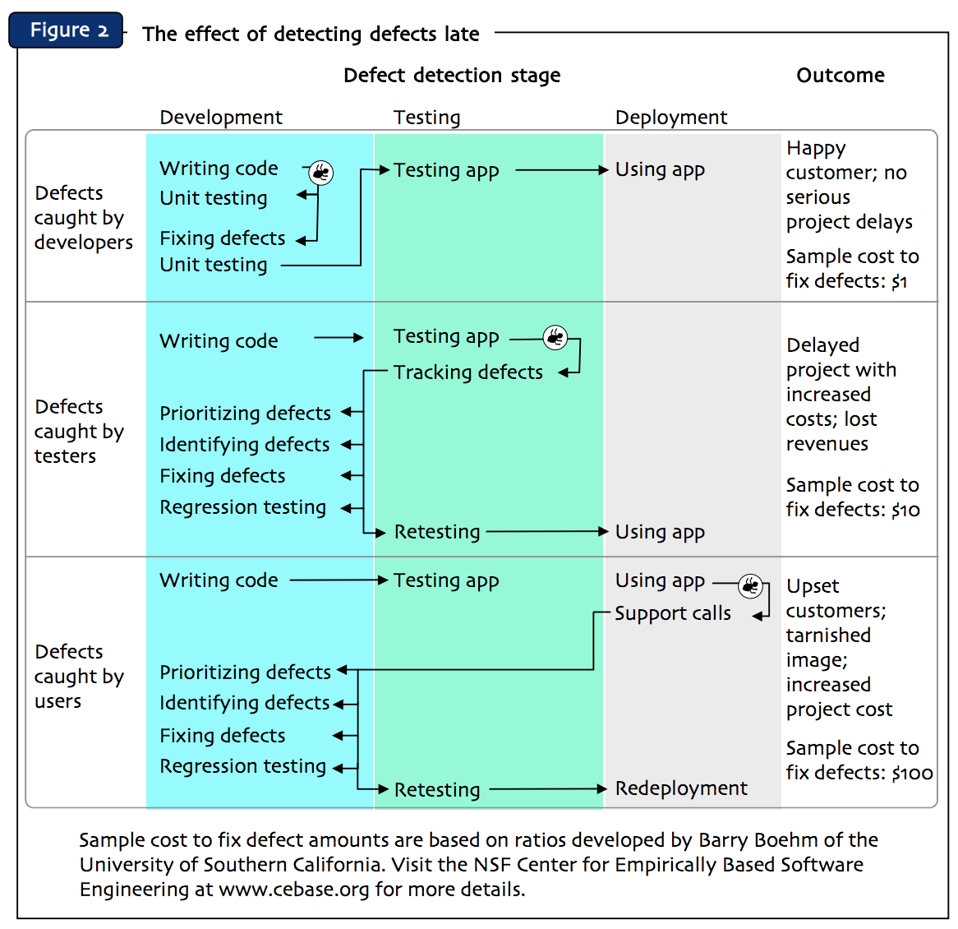
Credits: “Improving Software By Reducing Coding Defects”, Klockwork Inc. (2004)

Slide 7
Advantages
Testing accelerates development
Testing assures quality of software

Slide 8
Debugging !== Testing

Slide 9
Do it right
Testing needs to be planned
Can easily cost 40% of your budget
Shall be “reasonable”, independent and objective
Testing is a fundamental aspect of professional software development

Slide 10
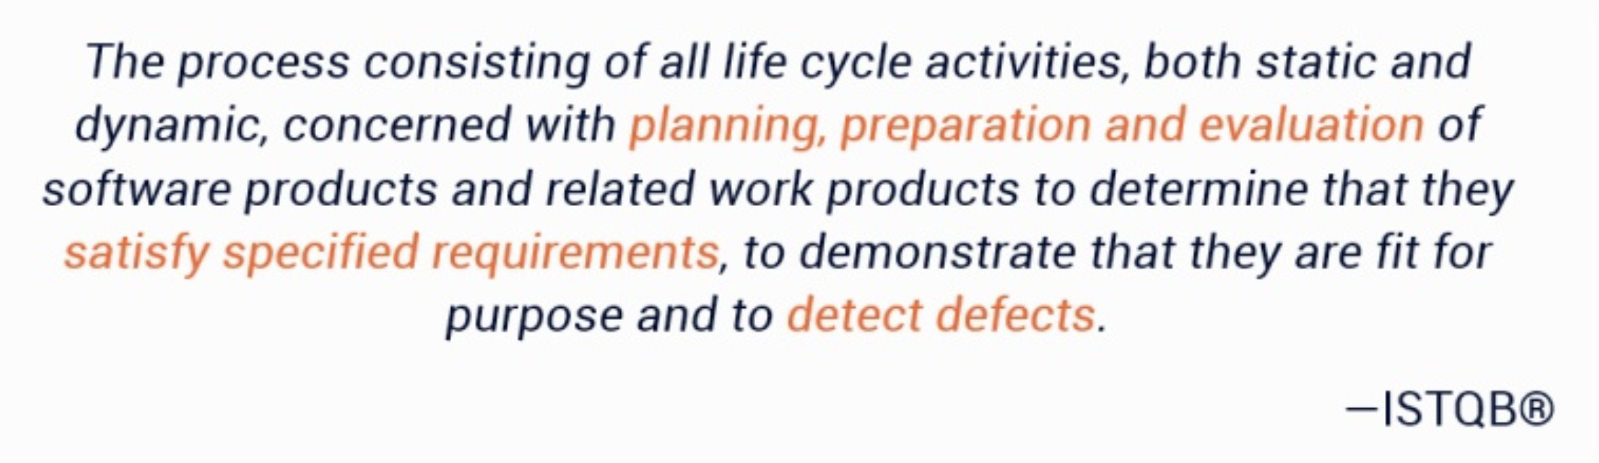
A definition of Testing

Slide 11
Validation and Verification
Validation: are we building the right product?
Verification: are we building the product right?

Slide 12
Static Testing
Objective: find defects
Verification only
Code is not executed
Test specs
Static analysis
Review

Slide 13
Static analysis
Examples
Syntax checking (your editor)
Code smell detection (e.g.: reek)
Coding standards compliance (e.g.: Rubocop)
Typical defects found
Syntax errors
Unreachable code
Overly complicated constructs

Slide 14
Review techniques
Informal review
Walkthrough (train the team)
Technical review (documented & defined process)
Formal inspection (to gain metrics)

Slide 15
Success Factors
Clear predefined objectives (what is important and why)
Defects found are welcomed and presented objectively
Application of appropriate review techniques
Review process supported by management
Emphasis on learning and process improvement

Slide 16
Coding standards
Increase readability and maintainability
Enforce a style to try and prevent bugs
Industry standards + Team standards
Static analysis to check compliance
Example: AirBnB style guides http://airbnb.io/projects/styleguides/

Slide 17
Dynamic Testing
Primarily verification
The code is executed
Objective: find failures
Different methods: black/white box
Different levels

Slide 18
Black-box vs White-box
Black-box
Based on specifications
No knowledge of the code
Observation of external behavior
White-box
Structure-based
Close examination of procedural level of detail
Knowledge of internals required

Slide 19
Unit Testing
Test individual units (usually functions) in isolation
Find defects in software components
Done by developers
In general, white-box

Slide 20
Ruby example
expect(factorial(10)).to eq(1*2*3*4*5*6*7*8*9*10)
Make sure a method does what it’s supposed to do
(in isolation from the rest of the code)

Slide 21
Integration Testing
Test communication/interaction among units
Unit integration and system integration
Done by developers
Mainly white-box but also black-box

Slide 22
System Testing
Test the complete system
Evaluate compliance with requirements
Stress, performance, usability, etc. testing
Done by (external) testers (involving the customer in Agile processes)
In general, black-box

Slide 23
Acceptance Testing
Test complete, integrated system
Evaluate compliance with acceptance criteria (e.g. critieria set for each user story)
May be performed at various times (e.g. in SCRUM at each sprint for each US)
Done by customers, users, product owners, …
Only black-box

Slide 24
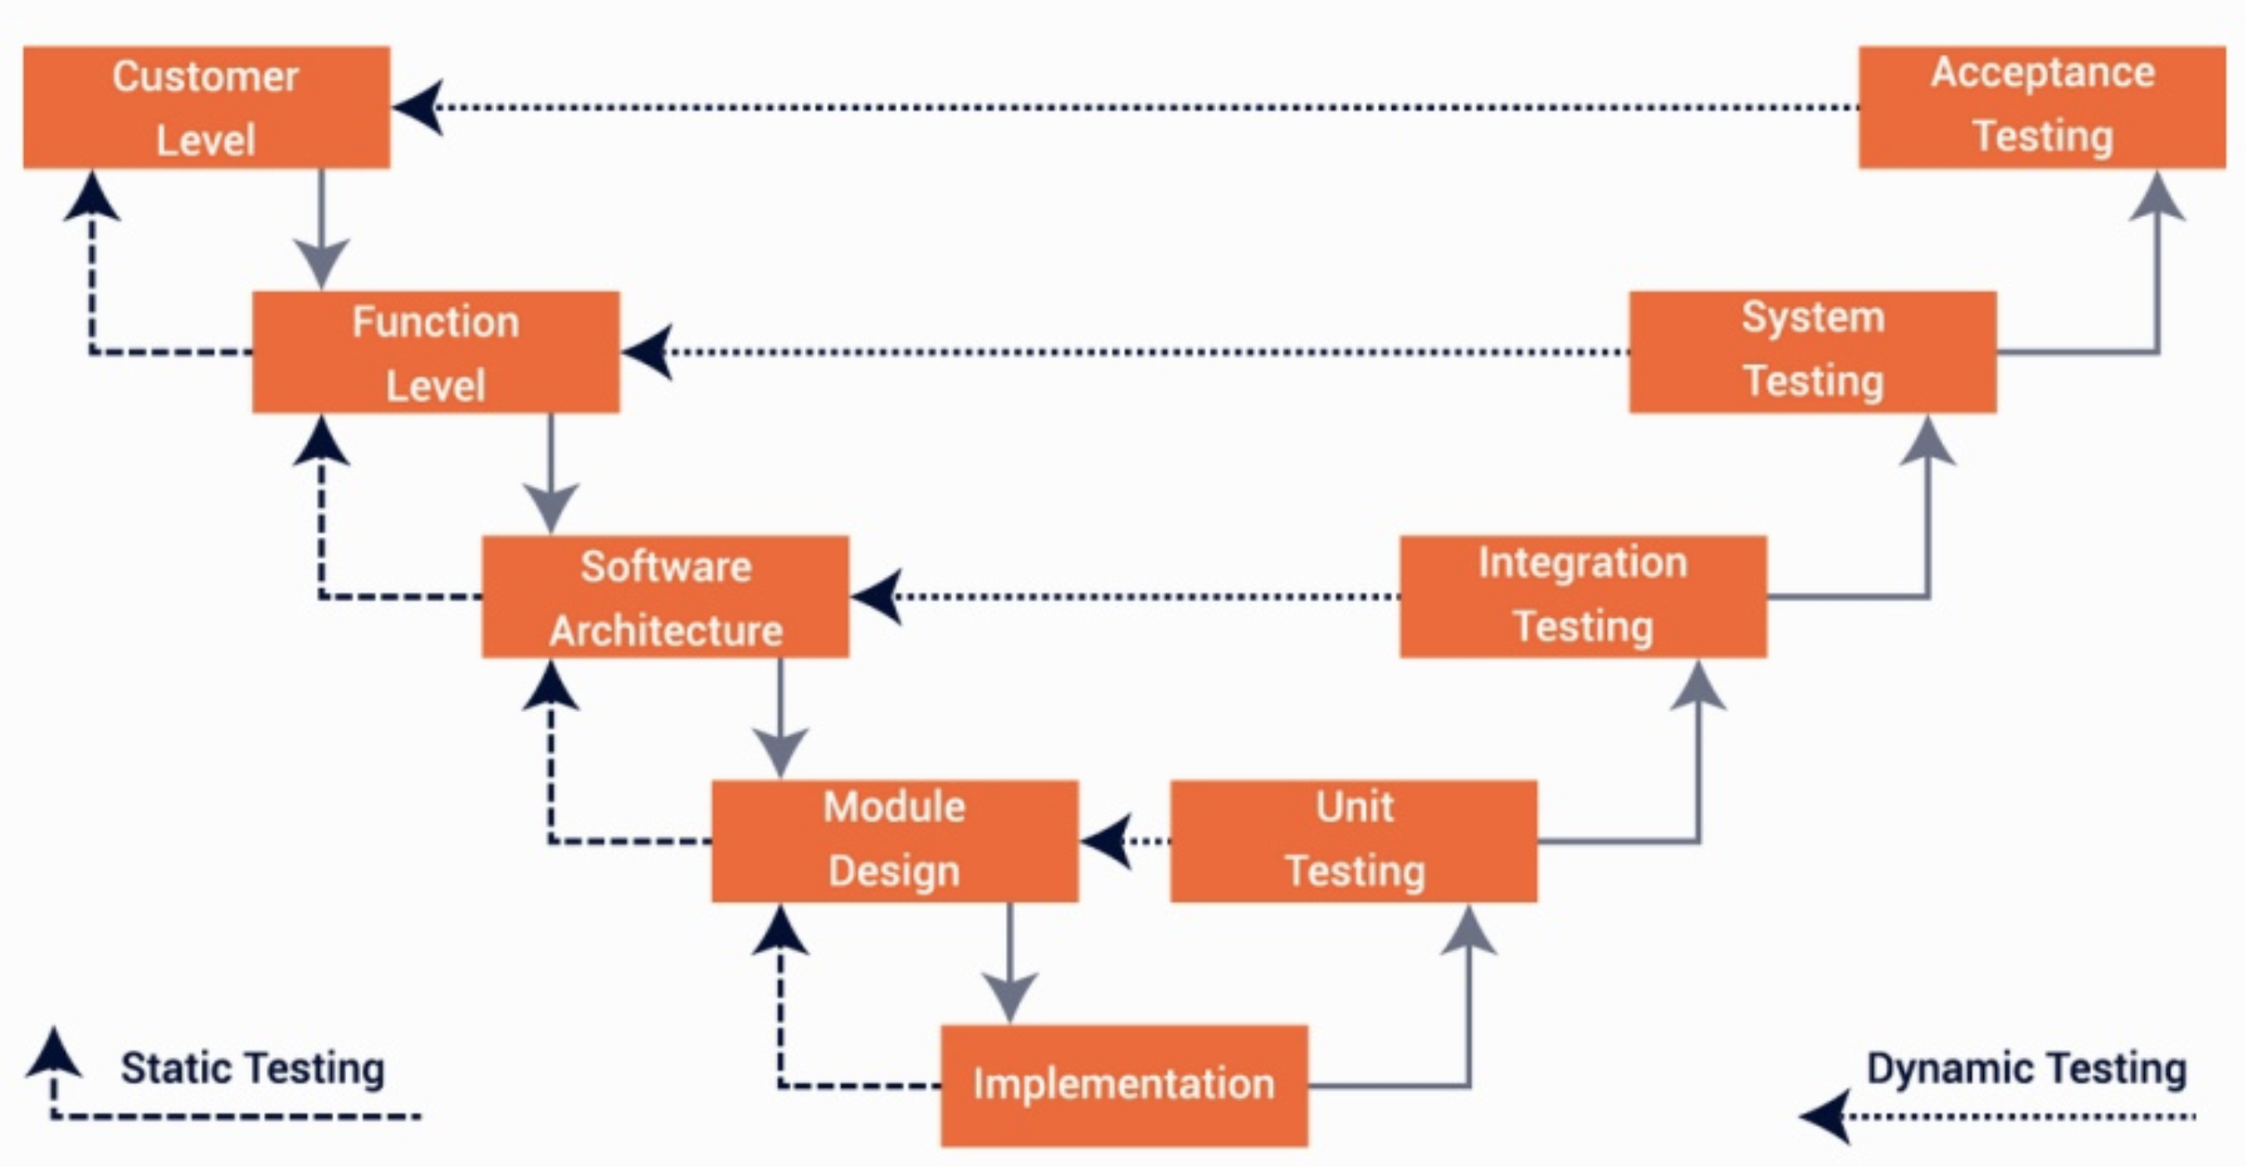

Slide 25
Regression Testing
Problem
You implemented some features
Then you implemented some more
…but you end up breaking the old features!
Purpose: ensure that new features have not introduced new faults

Slide 26
A simple example
Notes:
Esempio dal questionario

Slide 27
Agile Testing

Slide 28
Test-Driven Development (TDD)
Test-first approach
Think about “how to use a component” before “how to implement a component”
Mainly a design technique

Slide 29
TDD Process
Red
Green
Refactor
Write test
Run test & see it fail
Write (just enough) code to pass the test
Run test & see it pass
Refactor

Slide 30
BDD
Acceptance Criteria
Write failing test
Run test & see it fail
Write (just enough) code to pass the test
Run test & see it pass
Refactor
Write failing FEATURE

Slide 31
Feature
Format: As a _______________ I want to _____________ In order to _____________
Example: As an instructor I want to grade an assignment In order to give feedback to my students

Slide 32
Acceptance criteria
Describe scenarios that display the expected behavior
Example: Given I am an instructor And I am viewing the students submissions When I enter a valid grade Then the grade is displayed in the gradebook

Slide 33
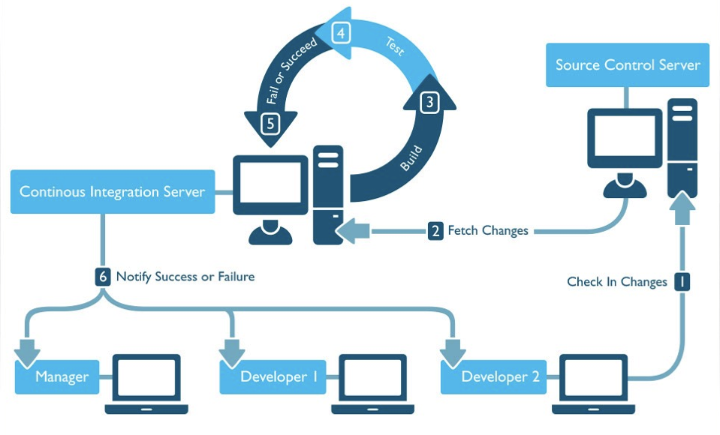
Continuous Integration/Delivery

Slide 34
Testing Rails apps
Static Analysis
Rubocop: check coding standards
Reek: check for code smells
Brakeman: detect security vulnerabilities
Eslint: lint JS code
Sass-lint: lint your stylesheets

Slide 35
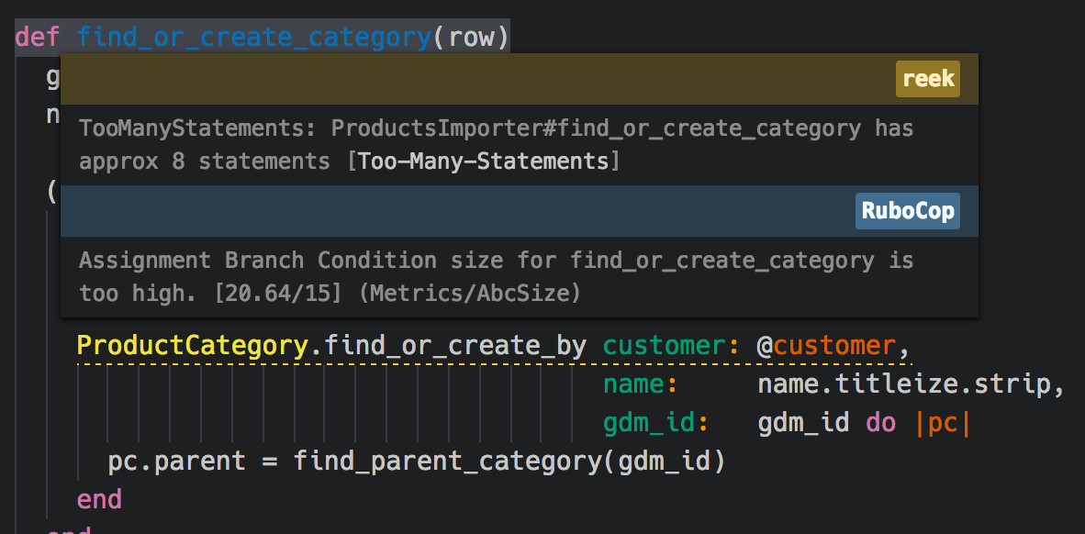

Slide 36
Testing Rails apps (2)
Unit Testing/TDD
Minitest (default)
RSpec (better, de-facto standard)
Acceptance Tests/BDD
Capybara
Cucumber

